Slide 1
LIGHT CHASING ROBOT
It Girls – End of Year
Level Creek

Slide 2
Think About It
This robot was inspired by other cool gadgets that can sense light and respond to it automatically
Ever see a street lamp flickering on at dusk?
Smart phone use light sensors to detect how dark it is around them.
This Photo by Unknown Author is licensed under CC BY-NC
Notes:
In this project, you will use light sensors to build a robot that chances light. You’ll also learn about motors, switches and light-dependent resistors.

Slide 3
PART A Wire Up The Motors
You are about to build a pair of circuits to power your robot. A circuit is a path for electricity to flow in a closed loop.
Complete all of the steps from page 6 – page 11.
Then STOP

Slide 4
You just added a switch!
Now, how does it work?

Slide 5
How Does a Switch Work?
When you turn on the switch, you complete your robot’s circuits and electricity can flow.
Complete
Circuit
m
Incomplete
Circuit
m

Slide 6
How Does a Switch Work?
ON Position
Inside the switch, a spring presses ambetal bar down onto metal pins.
When the switch is in the ON position, the bar touches the two pins where the black and purpose wires are attached.
Electricity flows through the metal bar, which complete the circuit
Complete
Circuit
OFF Position
When you flip the switch to the OFF position, the metal bar moves over so it touches the other pin.
That means that they black and purple wires aren’t connect anymore, so the loop is broken, and electricity can’t flow through the circuit.
m
Incomplete
Circuit
m

Slide 7
Wire Up the Motors Finish the steps
Complete the steps on Pages 13 – 16
Then stop

Slide 8
How Do Motors Work?
The relationship between electricity and magnetic fields are know as electromagnetism
Magnets make your motos move – here’s how!
Each motor contains an axle with three coils of wire attached. Around the axle and coils are two permanent magnets.

Slide 9
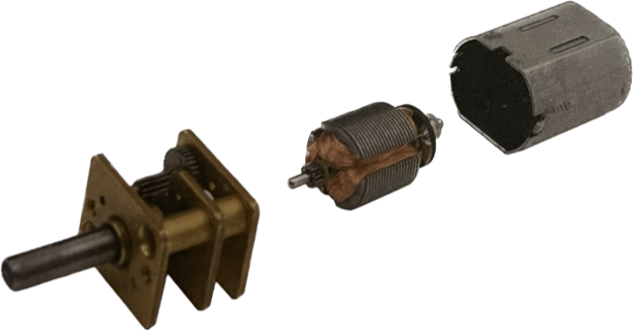
Motor Function
Changing the amount of electricity will change the speed of the motor (and your robot)!
Motor Body
The more electricity that’s flowing through the wires the stronger the magnetic field.
What happens when you have more electricity?
Axle
Wire Coils

Slide 10
Part B Build the Robot
Complete steps on pages 18 - 27

Slide 11
How Do Light Sensors Work?
When you add a resistor to a circuit, it limits the amount of electricity that can move through the circuit
Your robot’s light sensors use components called light dependent resistors. These control how much electricity can flow through the circuit.

Slide 12
Part C Adding a Skin
Only if Time Permitting
Follow pages 30 - 35

Slide 13
Driving Your Robot
Step 1: Flip the switch on your completed robot to “ON”
Step 2: Set the robot down and Shine the flashlight onto one of the light sensors. Then move the light to steer
Step 3: Set up the cones to make a race course!

Slide 14
Robot Wrap Up True or False
The light sensors produce the electricity to make the motor move.
A brighter beam of light will not change the speed of the motor.
Each light sensor controls the opposite motor.

Slide 15
Bonus Challenge
Can you make your robot run away from the light??
Notes:
Check it out on pages 40-44

Slide 16
WHAT TO EXPECT NEXT WEEK!
See you next year!
Notes:
Wrap Up and Ask the girls if they had fun

