Slide 1
IT Girls Presentation
By: Isabelle

Slide 2
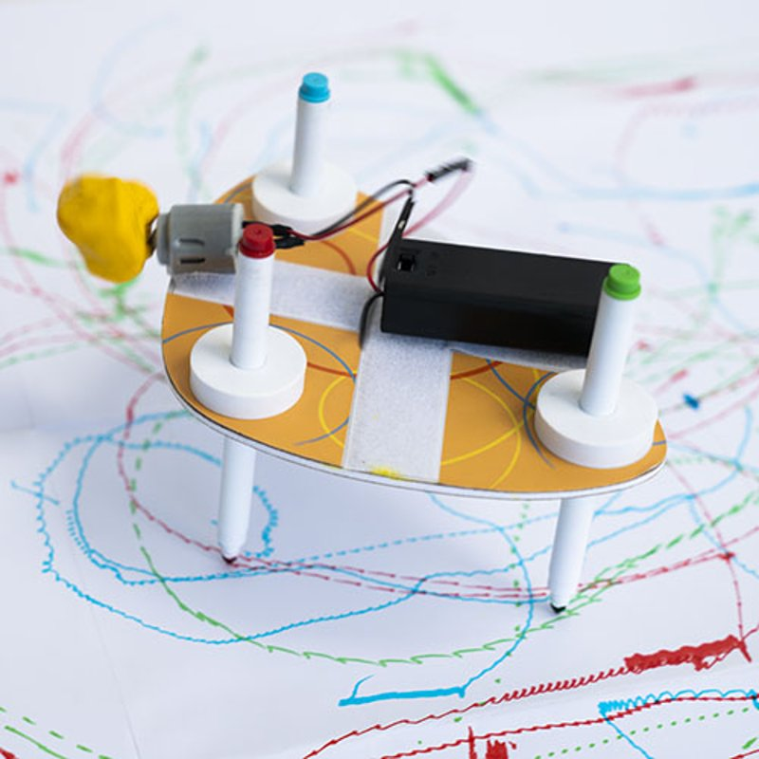
Table Of Contents
Learning about the bot
Working on the drawbot
Predictions
Other things!

Slide 3
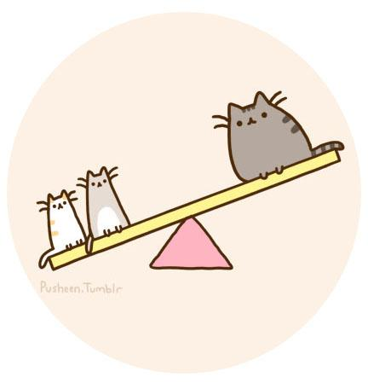
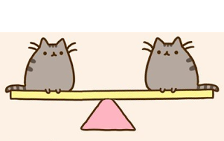
Learning about the bot
Learning about the bot was one of my favorite parts! I really enjoyed learning about it. I learned about the balance forces and unbalanced forces not so long ago when we learned about it in science class. Anyways, balanced forces is when someone or something is pushing a certain amount of force which is equal, and how it stays the same and a unbalanced force is when something or someone is pushing and something is heavier than the other.
A balanced force
A unbalanced force

Slide 4
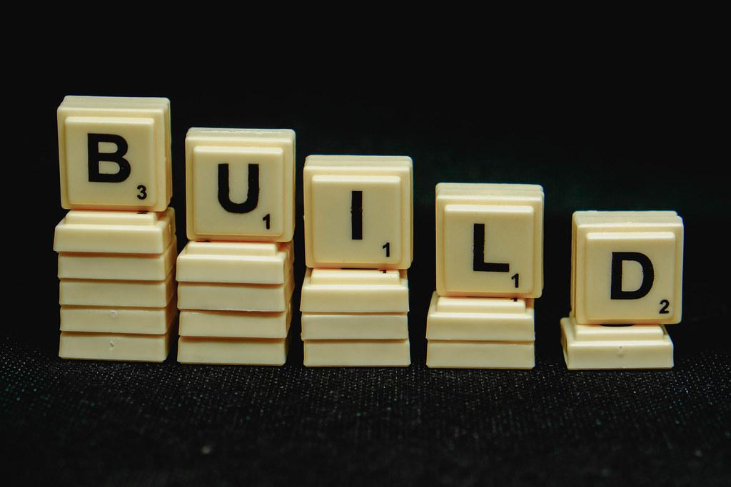
2. Working on the bot
Working on the bot was the BEST part! I really got to experience actually building something with motors and all of that. It actually was really fun to build and honestly, I would like to build something similar to the drawbot again! It was fun to learn more about it while we were building the bot.

Slide 5
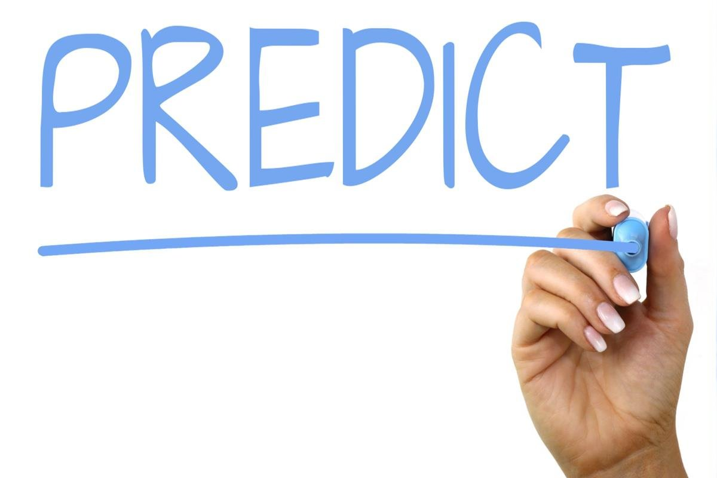
3. Predictions
Predicting was pretty complicated. I still enjoyed it though, and I was glad I still was able to build, predict, create, and enjoy! When I was predicting, I thought that it would go fast if I make it circular, and guess what… it worked! Predicting wasn’t really hard as I thought it would be. So, I guess predicting was pretty fun.

Slide 6
4. Other things!
Lastly, I wanted to say that I was glad to be able to participate in IT girls and do many fun things like making the drawbot and learning many things about science and technology. So… yeah. Bye!

